Slide 1

Entity-Relationship (ER) Model

Slide 2
What will you learn ?
Semantic modeling
ER Model Concept
Database Design with the E/R Model

Slide 3
Semantic modeling
Semantic features of relational data model
Codd: Capturing the meaning of data is a never-ending task
Semantic modeling: the overall activity of attempting to represent meaning
data modeling, E/R modeling, entity modeling, object modeling

Slide 4
Four broad steps of semantic modeling
Identify useful semantic concepts
Devise symbolic objects
Devise integrity rules
Devise operators
The ultimate objective of semantic modeling: make database system a little more intelligent
A more immediate objective of semantic modeling: provide a basis for database design
E/R approach—most commonly used, not the only

Slide 5
1. ER Model Concept
First introduced by P.PS.Chen(陈平山 美籍华人) in 1976 and has been popular in relational DB design and made part of a number of CASE tools.
A database can be modeled as:
  a collection of entities
  relationship among entities.
ER Model includes the following semantic objects
  Entities
  Properties
  Relationships
  Entity subtypes and supertypes

Slide 6
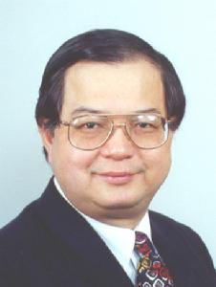
E-R模型最早由Peter Chen（陈品山）于1976年提出，它在数据库设计领域得到了广泛的认同，被誉为全世界最具计算机软件开发技术的16位科学家之一。
陈品山博士于1976年3月ACM Transactionson Database Systems上发表了《The Entity-Relationship Model—Toward a Unified View of Data》一文。由于大众广泛使用实体联系模型，而这篇文章已成为计算机科学38篇被广泛引用的论文中之一。
Notes:
让陈品山成为被众人熟知计算机科学家是因为他在麻省理工教学期间发表了实体关系模型论文，正是这篇论文，奠定了他在计算机科学领域的历史地位。而这篇文章也成为了被众多论文所引用的文章。

Slide 7
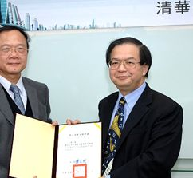
陈品山
1947年生，1968年，陈品山于国立台湾大学毕业，之后赴美国深造。1970年获哈佛大学计算机科学和应用数学硕士学位，1973年获哈佛大学计算机科学和应用数学博士学位。之后，他曾先后在麻省理工学院（1974-1978，1986-1987），加州大学洛杉矶分校（1978-1984），哈佛大学（1990-1991）等学府从事教学和研究，从1983年至今任路易斯安纳州立大学计算机科学系MurphyJ.Foster杰出讲座教授（DistinguishedChairProfessor）。
此外，陈品山博士还曾在IBM（6/1970-8/1970），Honeywell（6/1973-5/1974），迪吉多（6/1974-8/1974），以及其他政府机构从事研究和顾问。

Slide 8
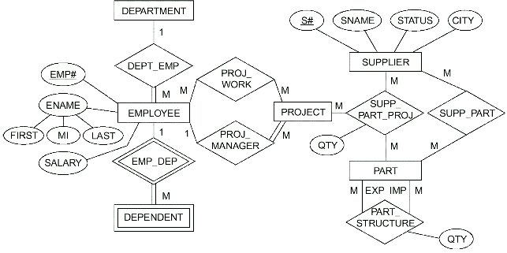
ER Diagram…
Fig. 13.2 Entity/relationship diagram

Slide 9
E-R Diagram : a technique for representing the logical structure of a database in a pictorial manner
E-R Diagram Components
  Rectangles represent entity sets.
  Ellipses represent attributes
  Diamonds represent relationship sets.
  Lines link attributes to entity sets and entity sets to relationship sets.
  Double ellipses represent multivalued attributes.
  Dashed ellipses denote derived attributes.
  Primary key attributes are underlined.

Slide 10
Entity
Entity:A thing which can be distinctly identified.
  e.g. specific student, company, event, plant
An entity set is a set of entities of the same type that share the same properties.
  e.g. set of all student, companies, trees, holidays

Slide 11

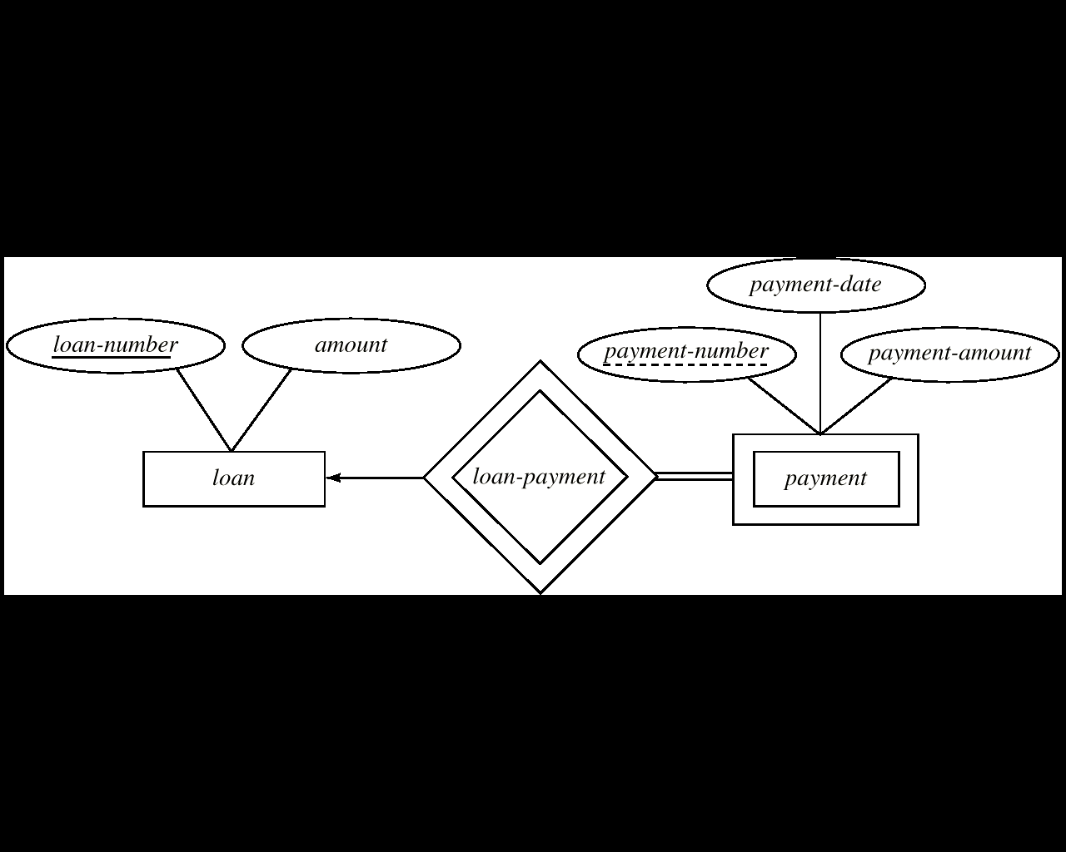
Entity …
Entity type:
  regular entities:
  weak entities: existence-dependent on some other entity, in the sense that it cannot exist if that other entity does not also exist.

Slide 12
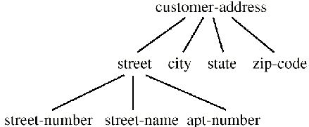

Properties
Properties:All entities or relationships of a given type have certain kinds of properties in common;
Properties can be
  Simple or composite:

Slide 13

Properties …
  Key:
  Single- or multi-valued
  Missing
  Base or derived
CITY
QTY

Slide 14
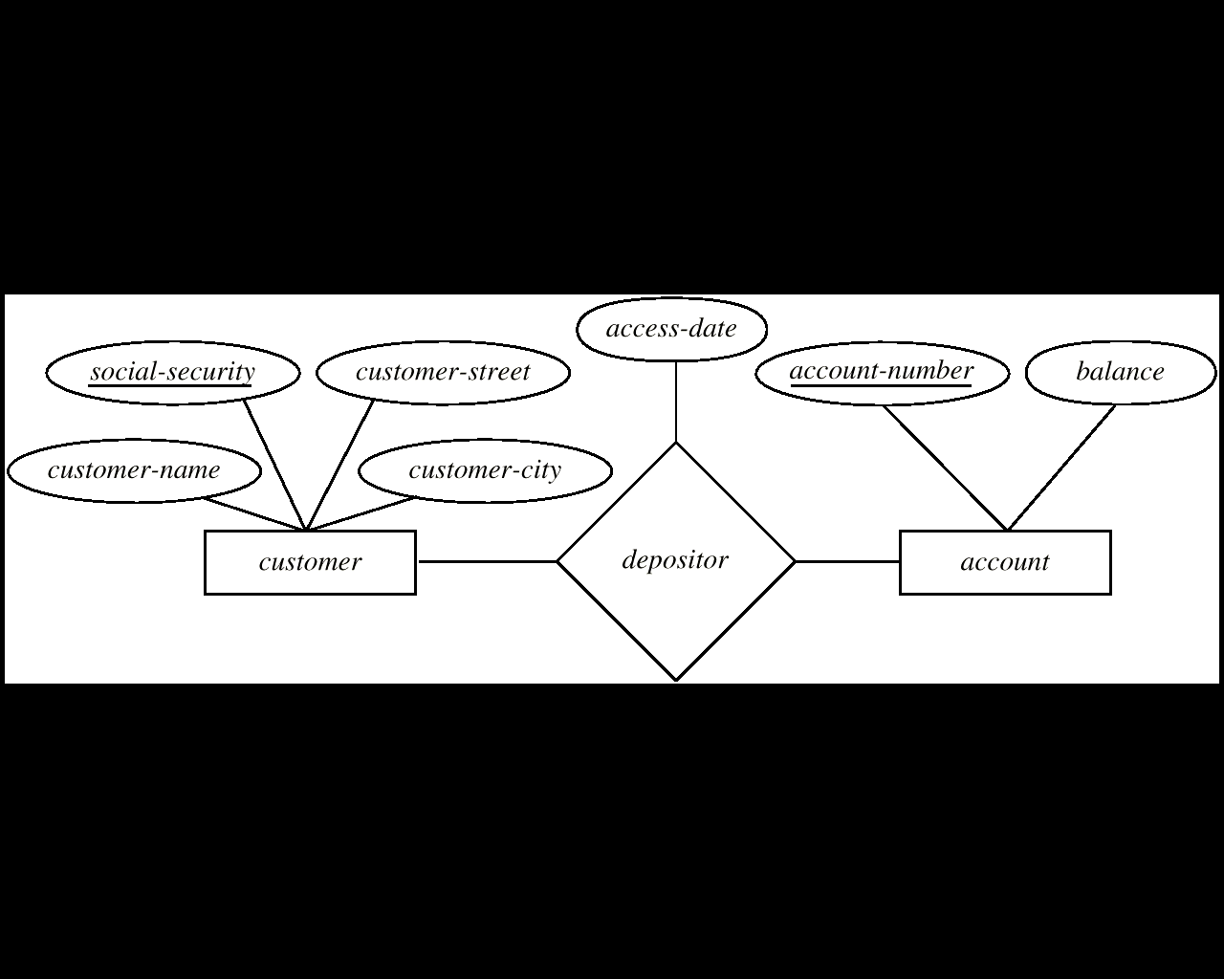
Relationships
  A relationship is an association among several entities.
1
1
an attribute can also be property of a relationship set.
Relationship set , relationship type

Slide 15
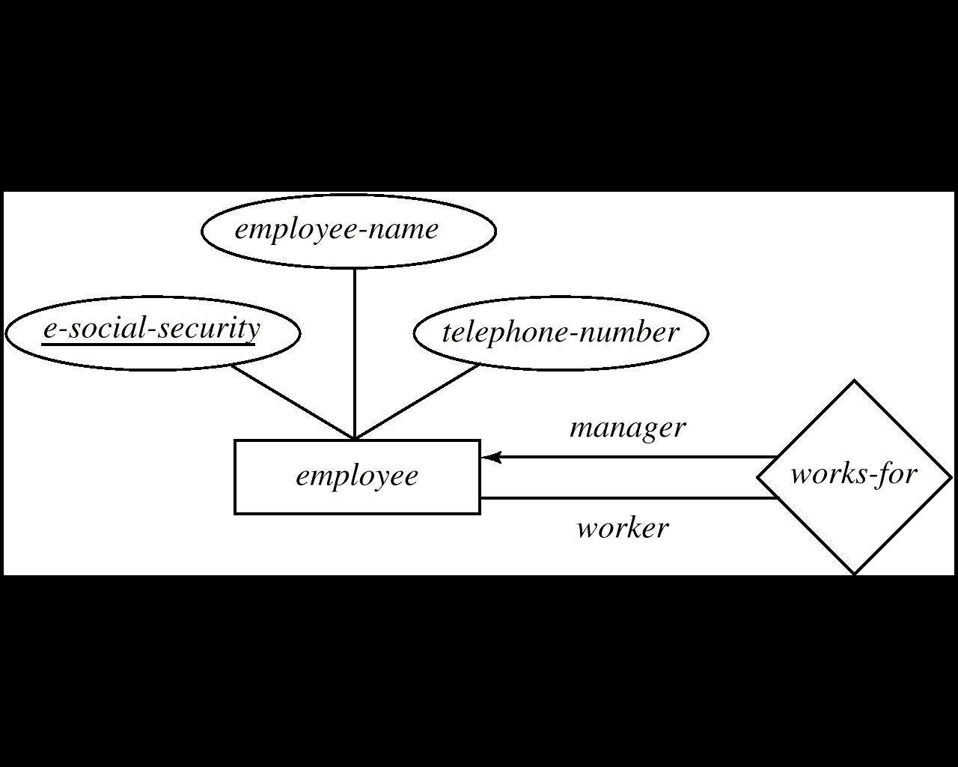
Relationships …
Entity sets of a relationship need not be distinct.

Slide 16
Relationships …
  The entities involved in a given relationship are said to be participants in that relationship.
  A relationship can include many entities;The number of participants in a given relationship is called the degree of that relationship.
    Binary relationship
    Ternary relationship
    N-ary relationship

Slide 17
Relationships …
Three types of Relationships
  one-to-one (1:1)
  one-to-many (1:n)
  many-to-many (n:m)
→or 1 : signifying “one”
—or m :signifying “many”

Slide 18
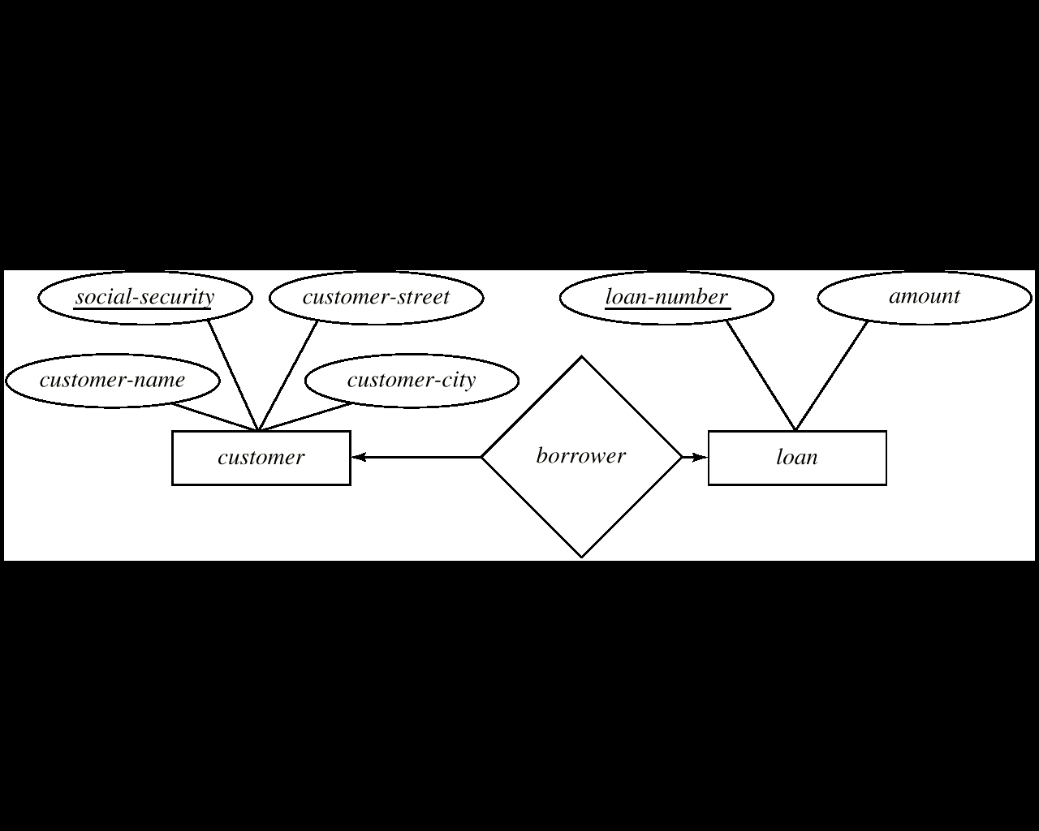
Relationships …
One-To-One Relationship
  A customer is associated with at most one loan via the relationship borrower
  A loan is associated with at most one customer via borrower.

Slide 19
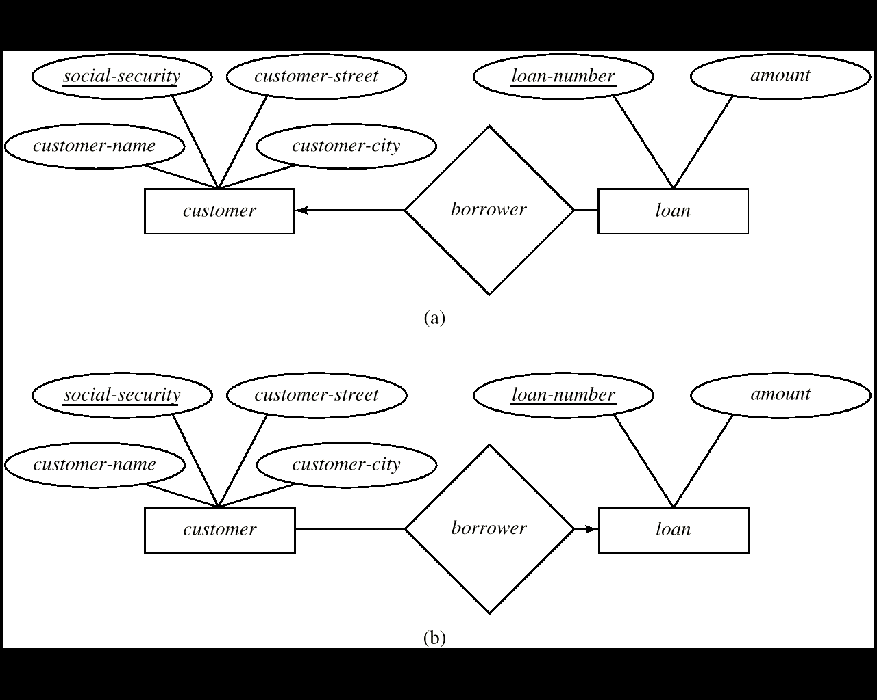
one-to-many / many-to-one
In the one-to-many relationship (a), a loan is associated with at most one customer via borrower, a customer is associated with several (including 0) loans via borrower
In the many-to-one relationship (b), a loan is associated with several (including 0) customers via borrower, a customer is associated with at most one loan via borrower

Slide 20
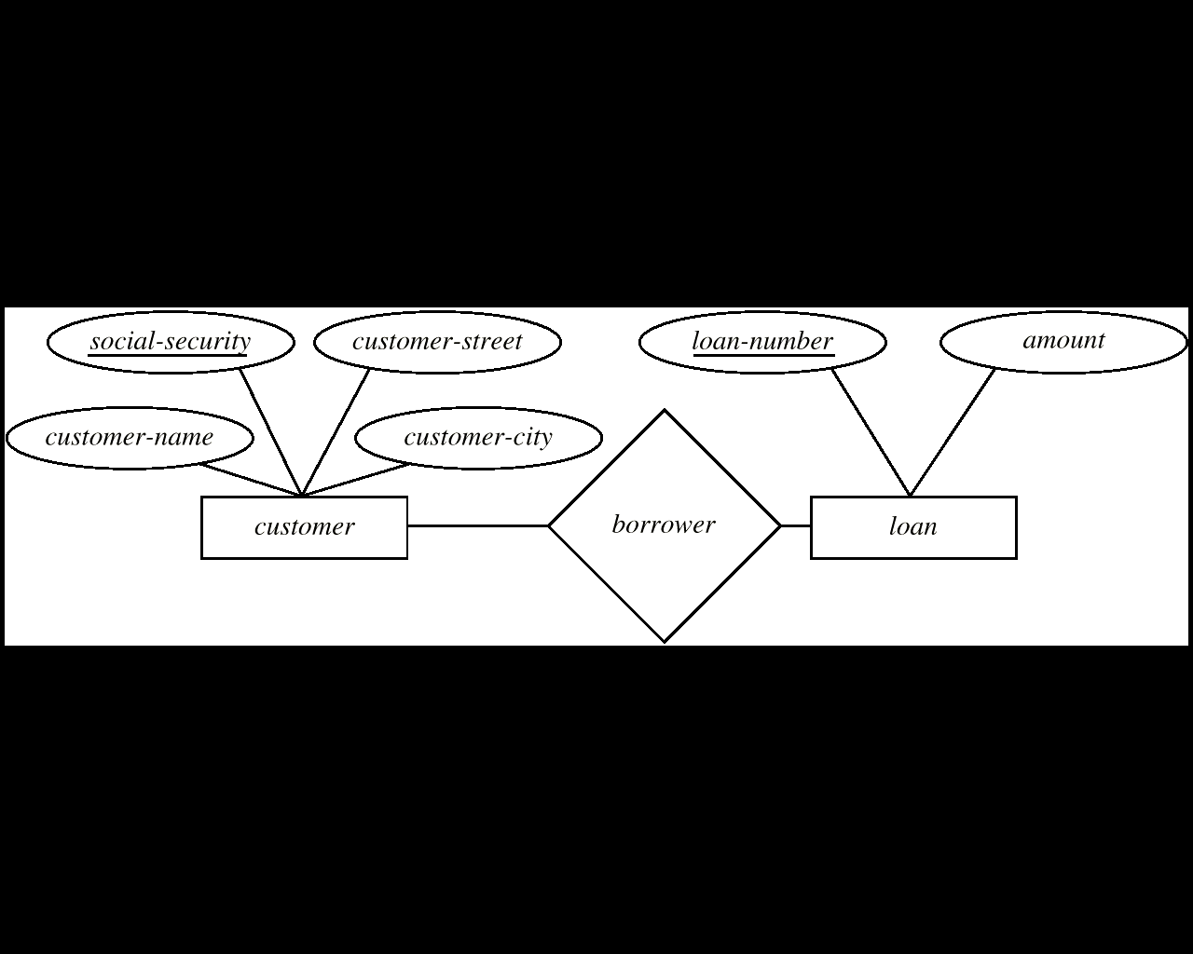
Relationships …
Many-To-Many Relationship
  A customer is associated with several (possibly 0) loans via borrower
  A loan is associated with several (possibly 0) customers via borrower

Slide 21
Relationships …
Participation constraints
  total participation: Every entity in entity type must be related to a related entity via a relationship type.
  partial participation:Some or part of the set of entities are related to a related entity via a relationship type, but not necessarily all.

Slide 22
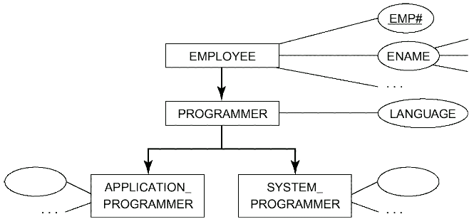
Entity Subtypes and Supertypes
如果某个实体型中的所有实体同时又是另一个实体型中的实体，那么前一实体型称为子类(Subtypes)，后一实体型称为超类(Supertypes)。

Slide 23
Entity Subtypes and Supertypes
Account-number
balance
account
ISA
Interest-rate
Overdraft-amount
Savings-account
checking-account
Properties and relationships that apply to the supertype are inherited by the subtype
ISA relationship

Slide 24
2. Database Design with the E/R Model
Regular Entities → base relvar
  Properties → attributes
  Identity → primary key
  E.G.
  VAR DEPT BASE RELATION
  {DEPT# DEPT#,DNAME NAME#,…}
  PRIMARY KEY {DEPT#};

Slide 25
Database Design with the E/R Model…
Many-to-Many Relationships: → base relvar
  Participants’s primary keys and properties of relationship → attributes
  Combination of the participant-identifying foreign keys → Primary key
  Participants’s primary keys →Foreign keys
  E.G.
  VAR SP BASE RELATION
  {S# S#,P# P#,…}
  PRIMARY KEY {S#,P#};
  FOREIGN KEY{S#} REFERENCES S
  FOREIGN KEY{P#} REFERENCES P;

Slide 26
Database Design with the E/R Model…
Many-to-One Relationships (involve only regular entity)
  Does not cause the introduction of any new relvars
  Just introduce a foreign key in the relvar on the ‘many’ side of the relationship that reference the relvar on the ‘one’ side
  E.G.
  VAR EMP BASE RELATION
  {EMP#…,ENAME…,DEPT#…,…}
  PRIMARY KEY {EMP#}
  FOREIGN KEY {DEPT#} REFERENCES DEPT;

Slide 27
Database Design with the E/R Model…
Weak Entities →base relvar
  Foreign key and properties of weak entity set→attributes
  Combination of the foreign key and weak entity key → primary key
  E.g.
  VAR DEPENDENT BASE RELATION
  {DEP_NAME…, EMP#…}
  PRIMARY KEY {DEP_NAME, EMP#}
  FOREIGN KEY {EMP#} REFERENCES EMP;

Slide 28
Database Design with the E/R Model…
Entity Subtypes and Supertypes
  Supertype →base relvar
  Subtype →base relvar with primary key the same as supertype relvar and with other properties of subtype,furthermore, its primary key is also foreign key
VAR PGRM BASE RELATION
{EMP#..,LANG…}
PRIMARY KEY {EMP#}
FOREIGN KEY {EMP#} REFERENCES EMP;

Slide 29
  The join of subtype and supertype (ISA) →view
  the join is one to one or zero to one
Var EMP_PGMR VIEW
EMP JOIN PGMR
  the view thus contains just those employees who are programmers
  If you can access properties
  that apply to all employees by….
  that apply only to programmars by …
  that apply to programmars by…
  Insert employees
  who are not programmers by…
  who are programmers by…

Slide 30
ER模型转关系模型实例（含拓展）

Slide 31
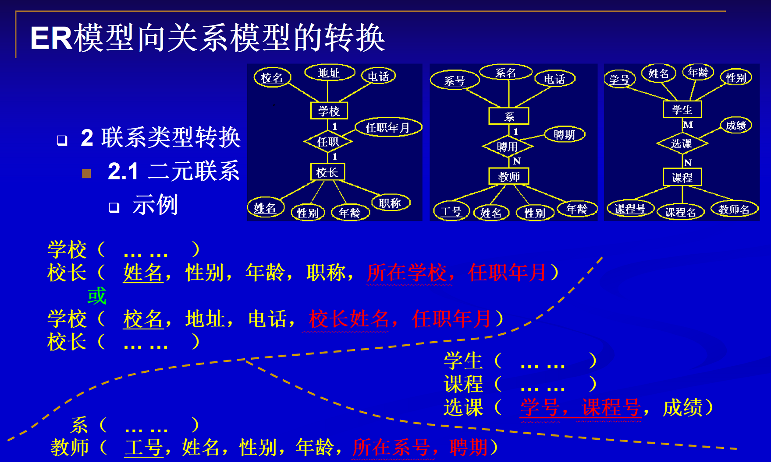

Slide 32
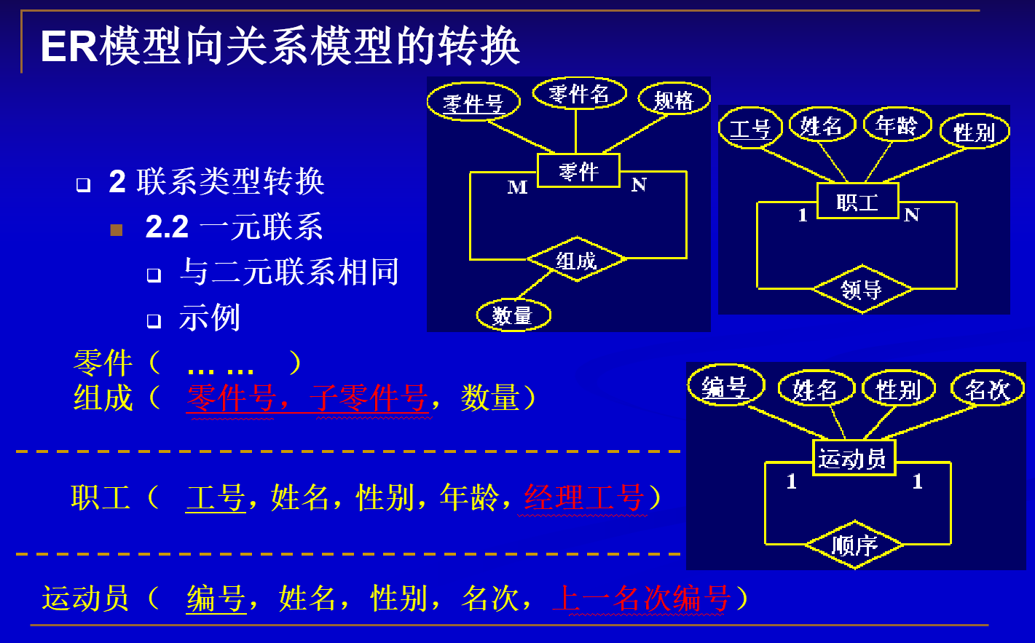

Slide 33
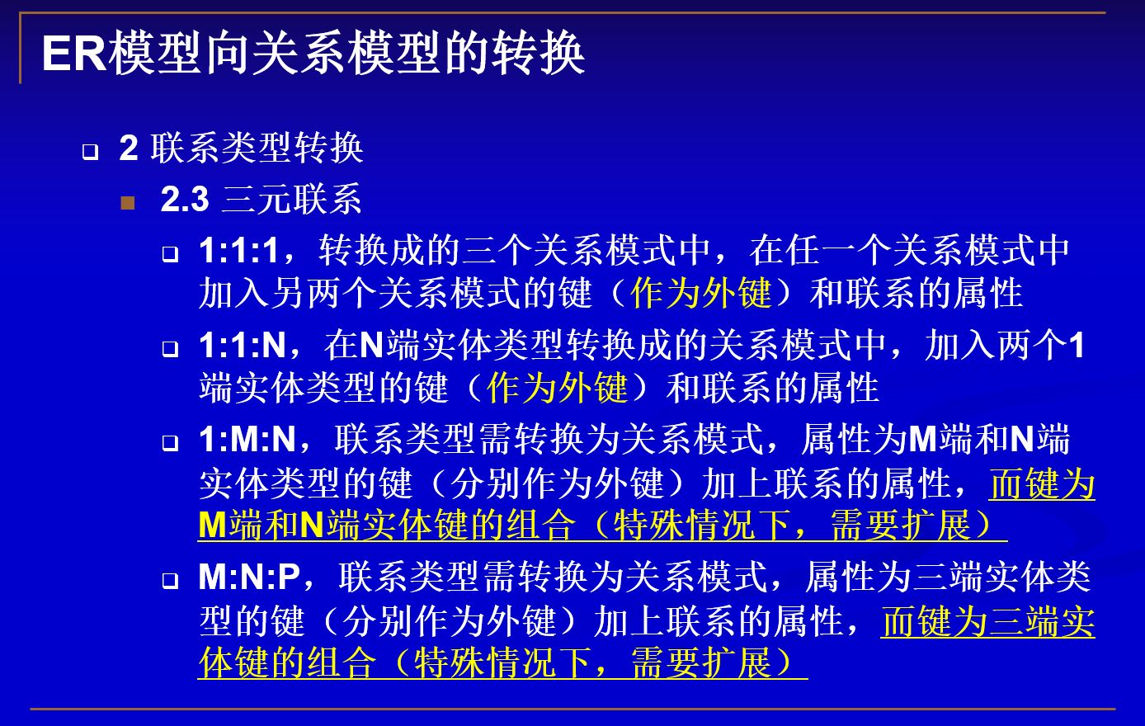

Slide 34
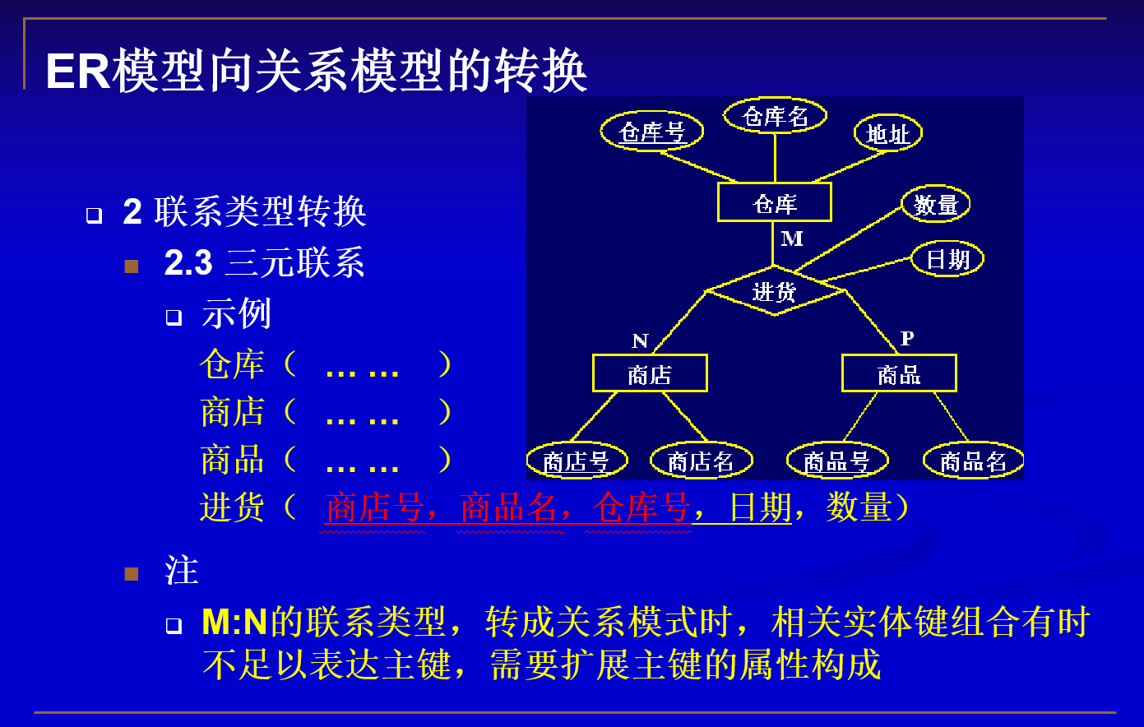

Slide 35
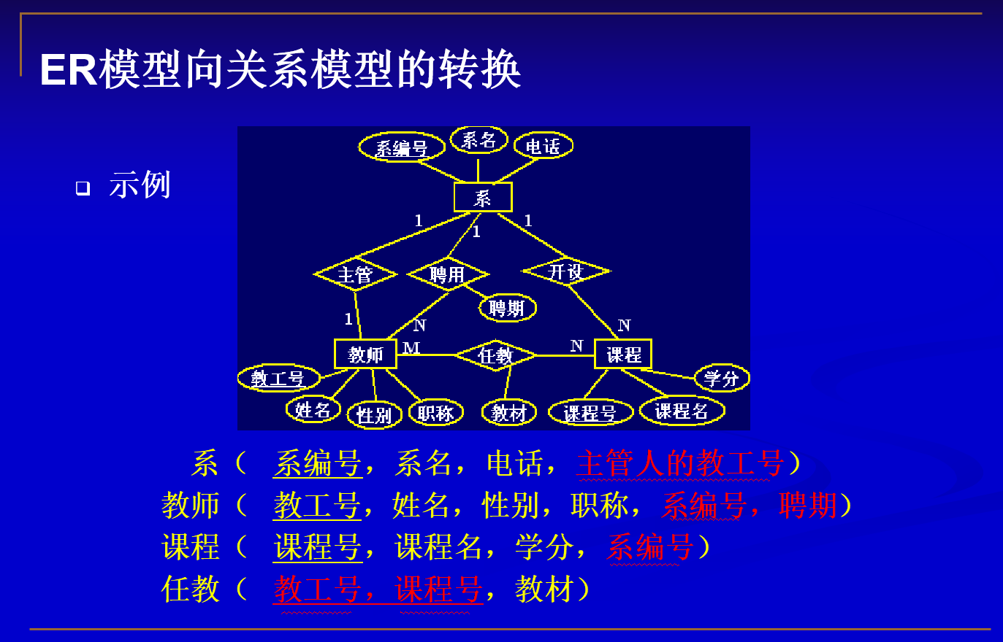

Slide 36
ER建模案例补充

Slide 37
案例1 有一家名为“阿里巴巴”的酒店，希望用计算机来进行酒店的管理。该酒店所管理的信息如下：
  酒店客户的个人信息：如客户的身份证号、姓名、性别、年龄、工作单位等。
  酒店客房的状态信息：如某间客房是否有空，某间客房住了哪位客户？该客户是何时入住的？等等。
  酒店客户的历史入住客房信息：即在过去的一年内，所有曾入住过该酒店的客户的每次入住的客房号、入住时间和退房时间等等。由此可以推算该客户在一年内入住酒店的天数，根据该信息可以决定客户在订房间时是否可以享受酒店的优惠政策。
  问题：
  1．该酒店应该用文件系统还是数据库系统来进行管理？简述其原因。
  2．如果用数据库应用系统来进行酒店的管理，你准备选择具有何种数据模型的数据库管理系统？为什么？

Slide 38
在案例1所给出的关于“阿里巴巴”酒店所要管理的信息的基础上，再增加如下的一些信息要求：
  客房信息：包括每间客房的客房号和客房类型（标准房、双人房、商务房）。
  定价信息：每种类型客房的定价。
  客房后勤服务信息：每间客房都有相应的雇员负责打扫，如果雇员的服务质量有问题的话，客户可以投诉，因此负责打扫客房的雇员信息包括雇员号、姓名、雇佣日期和被投诉次数等。另外，还应保存雇员及所负责的客房对照表，其中包括雇员号和客房号信息。
  酒店飞机订票服务信息：客户可以通过电话向该酒店的订票中心订票，订票中心需记下客户订购机票的时间，并询问客户所订机票的起始地、目的地和起飞时间。然后，通过网络向航空公司订票，订票成功就出票，即在预先准备好的空白机票上打印出如下的信息：机票号码、航空公司名称、客户姓名、起始承运人（即起始机场）、目的承运人（即目的机场）、航班号、座位等级、起飞时间、到达时间和机票价格等信息。出票后，订票中心需通知客户来取票。订票中心应保存每个客户的订票信息，如客户所订机票是否已经出票，已出票的机票是否已被客户取走等等。另外，订票中心还需保留各航空公司的名称和电话。
试根据上述信息要求，设计“阿里巴巴”酒店系统的E-R模型。

Slide 39
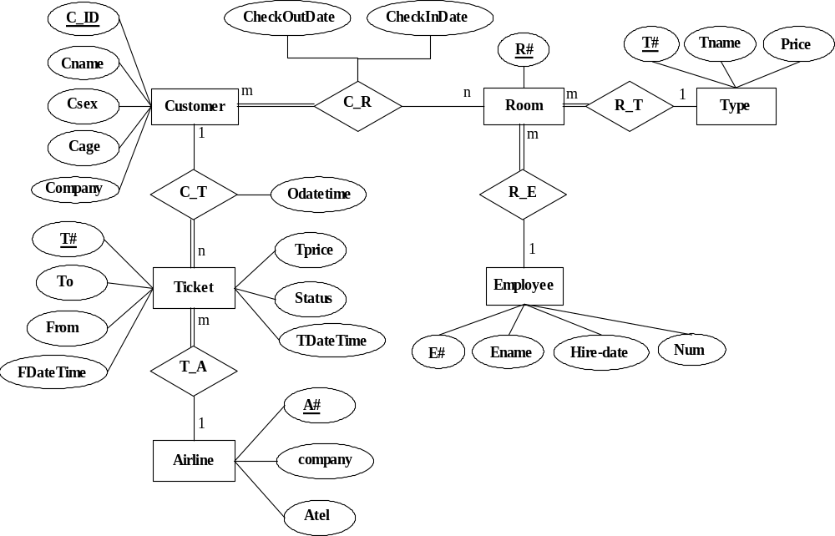
E-R Diagram

Slide 40
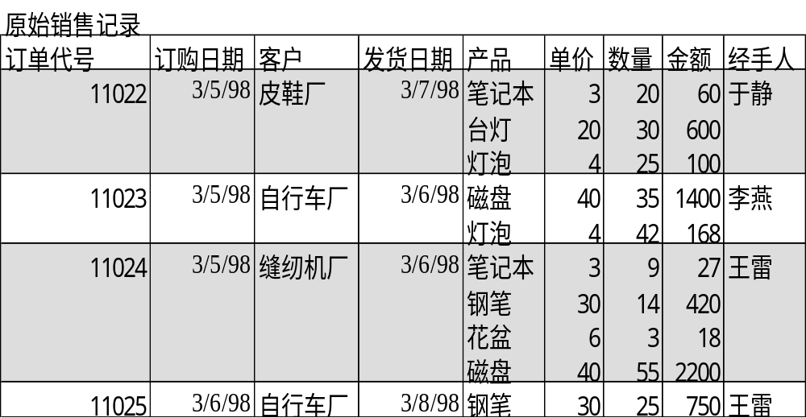
案例2 EFG公司的销售业务围绕着如图所示的销售记录的保存与处理而展开，现该公司要求创建一个为销售业务服务据库，试提供关于该数据库的设计资料
EFG公司销售记录样本

Slide 41
客户
1:M
订单
M:M
产品
M:1
雇员

Slide 42
客户
1:M
订单
1:M
订购
M:1
M:1
雇员
产品

Slide 43
客户关系
客户编号
客户名称
雇员关系
雇员编号
雇员名称
订单关系
订单编号
定购日期
客户编号
发货日期
雇员编号
产品关系
产品编号
产品名称
单价
库存量
订购关系
订单编号
产品编号
数量

Slide 44
Case 3
One toy producer produces toys of car, van, ambulance, truck and tractor. Each product comprises of several parts, the same parts could be used for different products. The parts are placed in two warehouses according to type of parts. Please draw the E-R diagram for the above background, identify the fields in each relation and define the key field for each relation.

Slide 45
warehouse
1:M
product
Product
composing
M:1
part
1:M

Slide 46
Case 4: a traffic accidents management branch
Redesign the following ER model
model
damage amount
name
year
license
social security#
driver
address
date
person
owns
car
log
accident

Slide 47
Date
owner
1
own
M
M
Involve
M
car
accident
M
Date of bought
location
Damage amount
have
Number of driver
M
1
apply
1
driver
licence
date

Slide 48
owner
social security#
name
address
age
……
car
License tag
type
social security#
Date of bought
……
accident
Accident_number
level
type
……
involve
License tag
Accident_number
date
location
Damage amount
……
have
License tag
social security#
Number of drivers
……
driver
social security#
name
Licence number
date
……
licence
Licence number
type
……

Slide 49
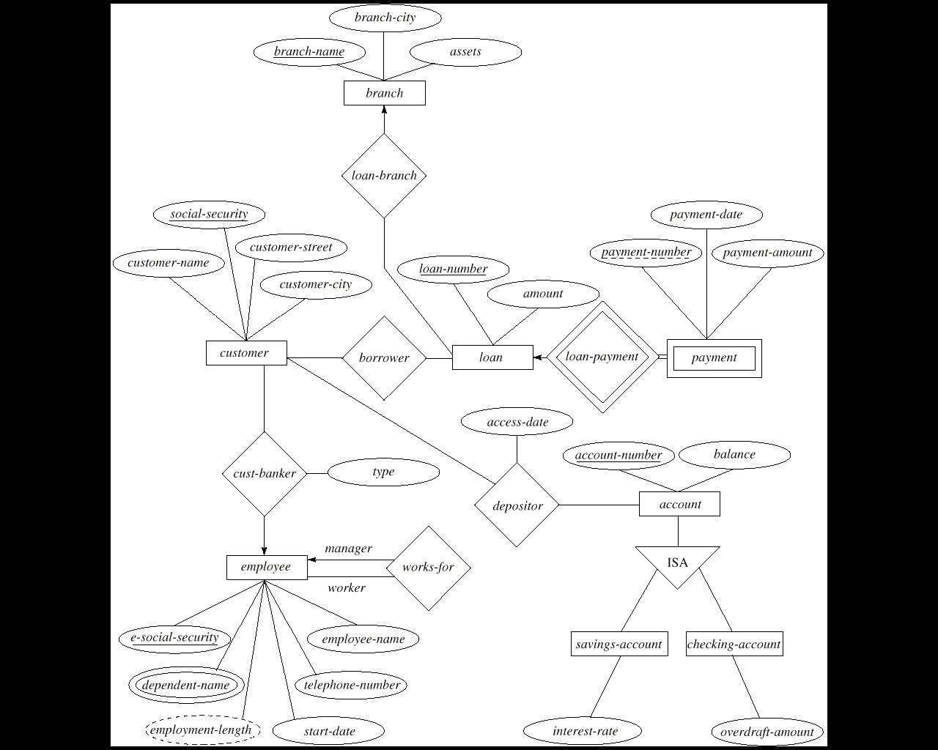
Case 5
E-R Diagram for Banking Enterprise

Slide 50
customer
customer-name
cust-social-security
customer-street
customer-city
loan
borrower
loan-number
amount
cust-social-security
loan-number
payment
loan-number
payment-number
payment-date
payment-amount
branch
Loan-branch
account
savings-account
checking-account
employee
emp-social-security
employee-name
phone-number
Start-date
dependent
…

Slide 51
group project—section 2
design an E-R model for your application
design the tables in the database

